Slide 1
Convolutional Neural Network (CNN) Theory and Practice
Imam Mustafa Kamal & Hyerim Bae
Industrial Engineering Department
Pusan National University

Slide 2
Outline
History of CNN
Application of CNN
Introduction
CNN Architecture & How it works
Variants of CNN
Practice using Python & TensorFlow

Slide 3
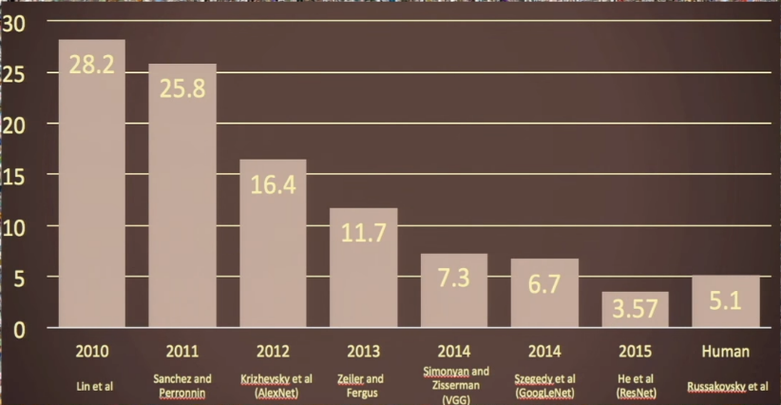
History of CNN
CNN (Convolutional Neural Networks) was invented by Yann LeCun in 1998
The first paper title: Gradient-Based Learning Applied to Document Recognition
The popularity of CNN (Deep Learning) was extremely increasing after it always won in ImageNet Challenge (A computer vision world-cup) in 2012
For text recognition
Using CNN
Error rate
Fe-fei Li, et. al, CNNn23 Stanford Univ. 2017

Slide 4
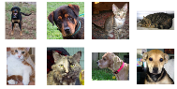
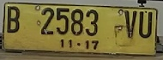
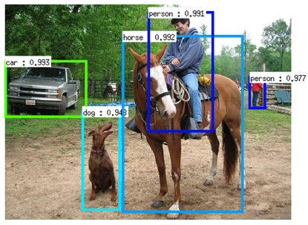
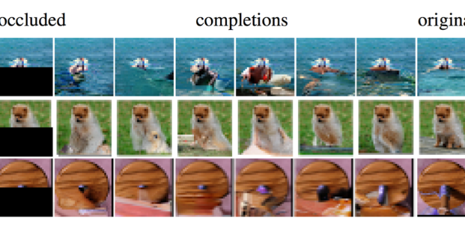
Application of CNN
dog
CNN
Image Classification
OCR (Optical Character Recognition)
Object Detection
Image Generation
cat
CNN
B2583VU

Slide 5
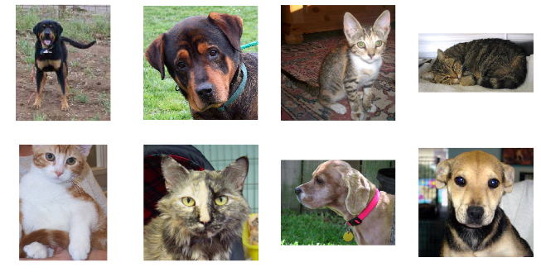
Introduction (1)
How do human know the classification?
Which one is cat and which is dog
and how do you know ?
How computer can know ?

Slide 6
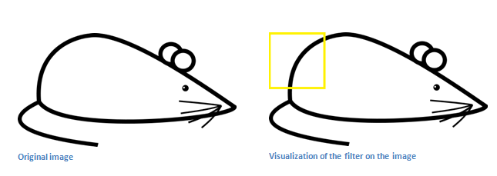
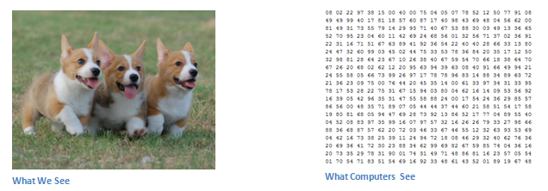
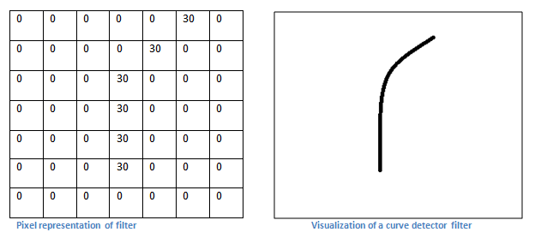
Introduction (2)
How do computer know the classification?
Let computer find out the pattern

Slide 7
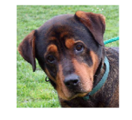
Introduction (3)
dog
CNN
cat
X
Same as a human, we need to train a CNN to understand
which is a dog and which is a cat based on data
How many data the computer required for correctly classified object ?

Slide 8
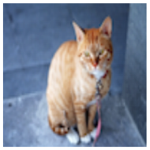
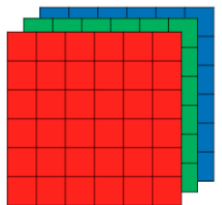
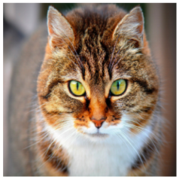
Introduction (4)
(1000, 3M)
Cat? (0/1)
x₁
(3 billion x 2)
x₂
64x64
x3
0
….
….
….
1
x_{n}
3M
1000 Neurons
1000x1000
x3 = 3 million
How if the input has high resolution ?

Slide 9
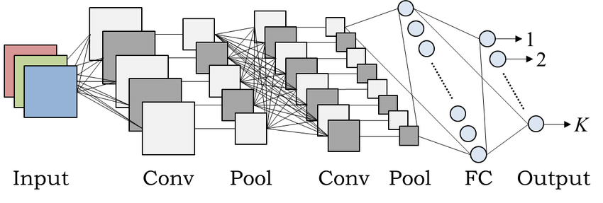
CNN Architecture
Input
Convolutional layer
Pooling layer
Flattened layer
Fully Connected layer
Feature extraction
Classification
Image source: Akinori Hidaka, Takio Kurita, Consecutive Dimensionality Reduction by
Canonical Correlation Analysis for Visualization of Convolutional Neural Networks

Slide 10
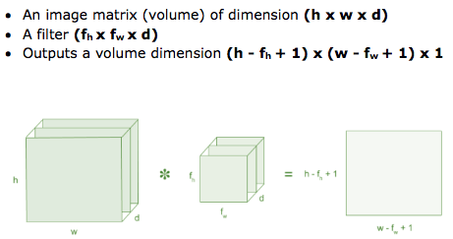

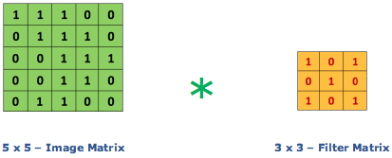
Convolution Layer (1)
filter/kernel
Receptive field

Slide 11
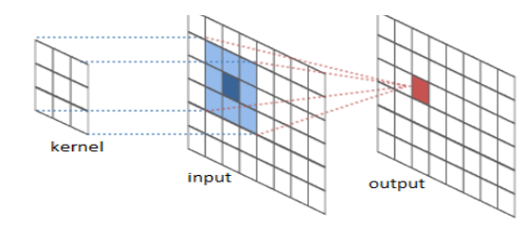
Convolution Layer (2)

Slide 12
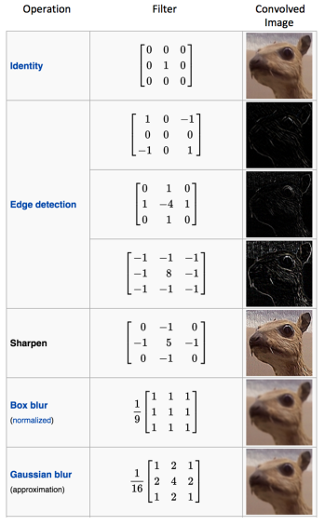

Convolutional Layer (3)
Filter / kernels
The output of convolutional layer is the important features like edge, curve, dominant colour etc.

Slide 13
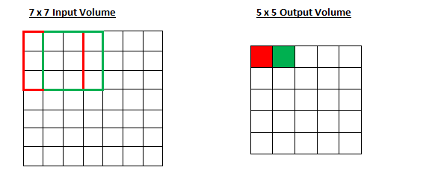
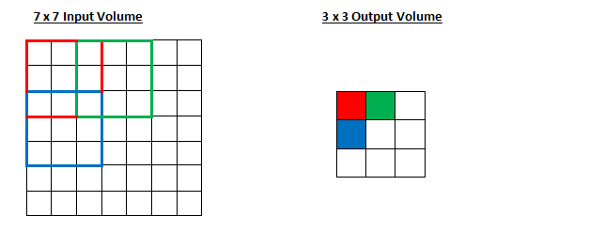
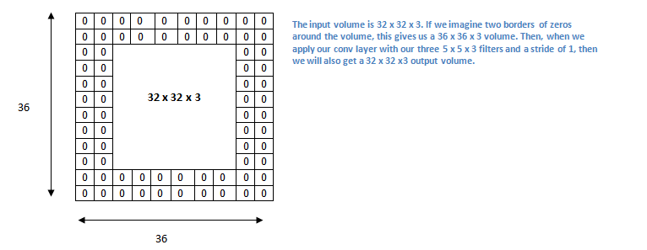
Strides and Padding (1)
One stride
Two stride
Propose zero padding!
Two zero padding
Convolve with 3x3 kernel, stride 1
Convolve with 3x3 kernel, stride 2
So, what is the effect of strides in the output images ?
The image dimension is getting smaller and smaller, we can loss the information

Slide 14
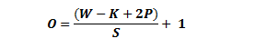
Strides and Padding (2)
How to preserve the input dimension
To avoiding the decreasing image dimension in each layer, we must apply zero padding
The formula for calculating the output size for any given conv. layer is
where O is the output height/length, W is the input height/length, K is the filter size, P is the padding, and S is the stride.

Slide 15
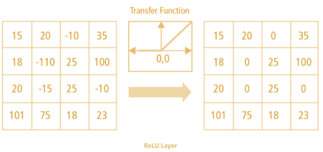
ReLu Activation Function
Rectified Linear Unit (ReLu)
ReLU stands for Rectified Linear Unit for a non-linear operation.
ƒ(x) = max(0,x)
+
ReLu
+
ReLu

Slide 16
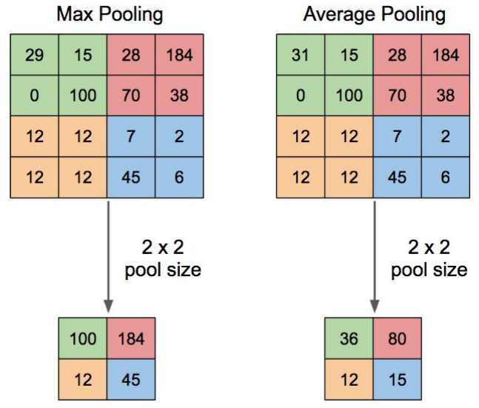
Pooling Layer
Pooling layer applies non-linear downsampling on activation maps.
Pooling is aggressive in discarding information
Types of pooling layer:
Max Pooling
Average Pooling
Sum Pooling

Slide 17
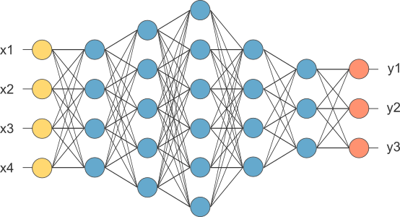
Fully Connected Layer (1)
Neural Networks !
Flattened the output from convolutional layer
The fully connected networks is used for feature classification
The last layer uses SoftMax activation function (for classification)
2D
Vector 1D
How many neuron in each layer?

Slide 18
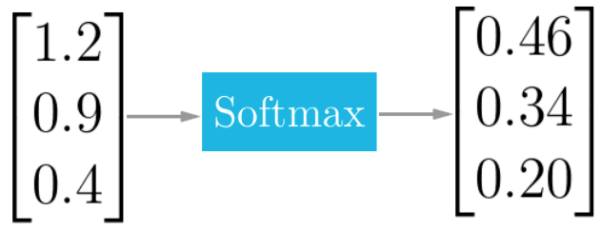
Fully Connected Layer (2)
The softmax function squashes the outputs of each unit to be between 0 and 1
The output of the softmax function is equivalent to a categorical probability distribution
Index having highest value represent the output
cat
dog
lion
+
SoftMax

Slide 19
Learning
What dimension and kind of filter/kernel that we use ?
What is the weight value that we use ?
We just need to initialize the value, and let the CNN through learning set the final filter and weight value itself.
However, the number of layer and type of activation function are chosen based on your trial experiments.
Back-propagation as supervised learning!

Slide 20
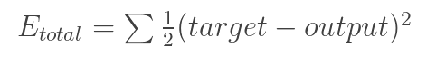
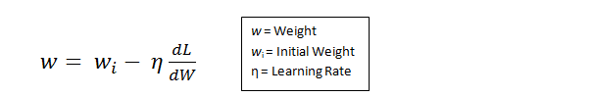
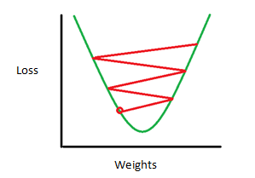
Optimization
Compute Loss
Type of optimization in DNN
Gradient descent
Stochastic gradient descent
AdamOptimizer, etc.

Slide 21
Summary of How CNN works (1)
Provide input image into convolution layer
Choose parameters, apply filters with strides, padding if requires. Perform convolution on the image and apply ReLU activation to the matrix.
Perform pooling to reduce dimensionality size
Add as many convolutional layers until satisfied
Flatten the output and feed into a fully connected layer (FC Layer)
Output the class using an activation function (SoftMax) and classifies images.
+
ReLu
+
ReLu

Slide 22

Summary of How CNN works (2)

Slide 23
Advance of CNN
How to choose the best architecture ? it depends on our case
There is no standard architecture, like how many conv. Layer, pooling layer, strides, and number of fully connected layer. Do a trial experiment !

Slide 24
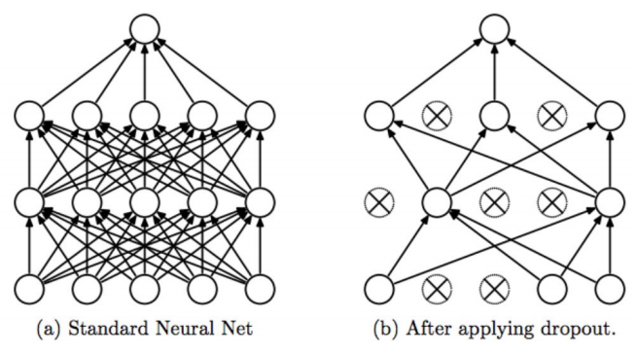
Dropout
During training, randomly ignore activations by probability p
During testing, use all activations but scale them by p
Effectively prevent overfitting by reducing correlation between neurons

Slide 25
ImageNet Challenge
Error rate in classifying objects
Error rate
Fe-fei Li, et. al, CNNn23 Stanford Univ. 2017

Slide 26
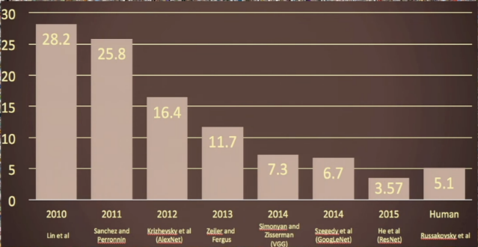
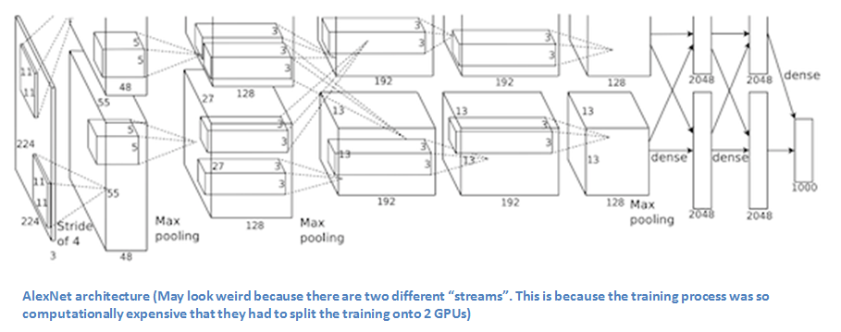
Variant of CNN (2)
AlexNet (2012) : Alex Krizhevsky, Sutskever, and Hinton
7 Layer
ReLU
Drop Out Layer
Jittering
Stochastic Gradient Descent
GTX 580 GPUs for five to six days

Slide 27
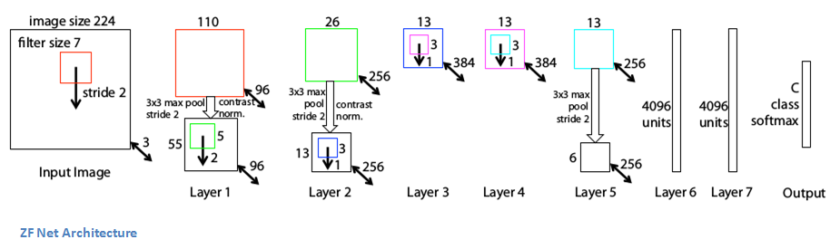
Variant of CNN (1)
ZF Net (2013): Matthew Zeiler and Rob Fergus
7 Layer
Very similar architecture to AlexNet
Instead of 11x11 sized filter it uses 7x7
2 Strides instead of 4 strides
Trained on a GTX 580 GPU for twelve days

Slide 28
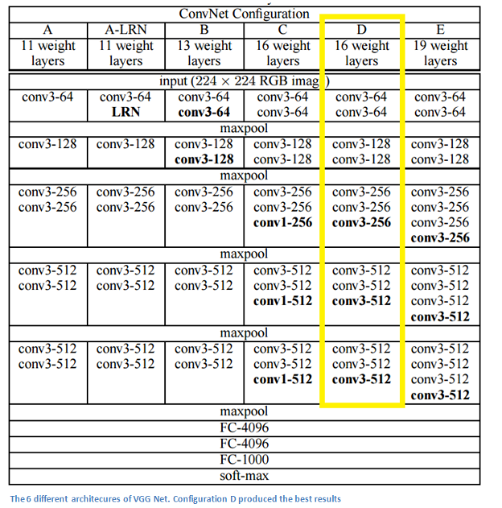
Variant of CNN (3)
VGG Net (2014): Karen Simonyan & Andrew Zisserman
19 Layer
3x3 filter sized
Jittering technique
Trained on 4 Nvidia Titan Black GPUs for two to three week

Slide 29
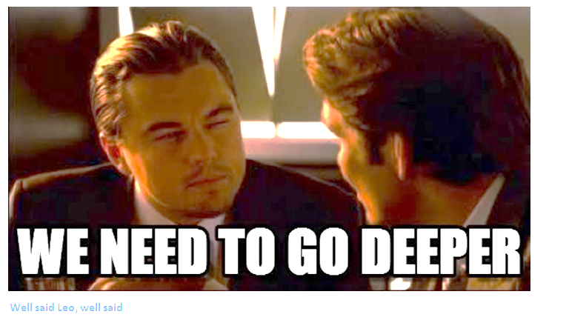

Slide 30
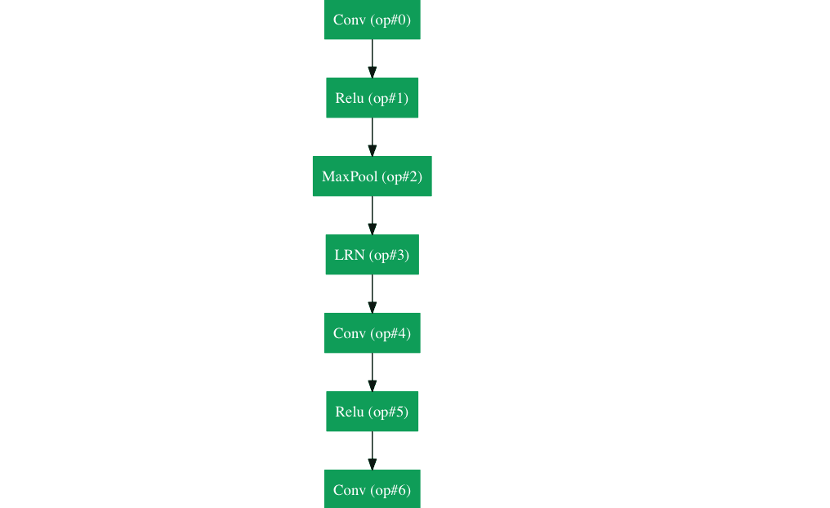
Variant of CNN (4)
GoogleNet (2015): Christian Szegedy et al.
100 layers :
9 Inception module

Slide 31
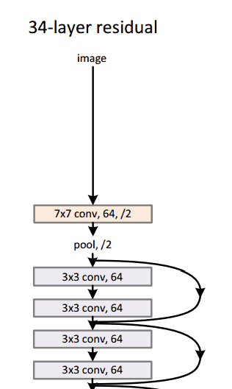
Variant of CNN (4)
Microsoft ResNet (2016): Kaiming He et al.
Ultra deep 152 Layers
Residual block

Slide 32
References
http://cs231n.github.io/convolutional-networks/
Cs231n Stanford University Course

Slide 33
Thank You
Imam Mustafa Kamal

